Slide 1
Comparison of WQS, qgcomp, BKMR, and BWS in Modeling Environmental Mixtures
Weijia Qian

Slide 2
Introduction
Environmental epidemiology increasingly faces the challenge of analyzing complex, high-dimensional, and highly correlated environmental exposures
Several novel statistical methods (environmental mixture methods) has been developed, but few studies have compared the results obtained from different methods
Goal: comparing four mixture methods in estimating the joint effects of exposure mixtures and identifying key contributors to health outcomes
A combination of simulation study and real data application

Slide 3
Mixture methods
Weighted quantile sum regression (WQS)
Constructs an exposure index by taking a weighted average of all exposures and fit a GLM
Assumes linear and additive individual effects
Separate analyses need to be conducted to estimate the “positive” versus “negative” joint effect
Quantile g-computation (qgcomp)
Uses G-computation to estimate the total effect of a mixture, and estimates the contribution of each exposure to the total effect
Weights can be negative or positive
Allows non-linear and non-additive individual effects by including product terms

Slide 4
Mixture methods
Bayesian kernel machine regression (BKMR)
Uses a gaussian kernel to create exposure matrix
Flexible and allows for non-linear associations
Provides estimates of the posterior inclusion probability for individual exposures
Bayesian weighted sums (BWS)
Estimates the total mixture effect and individual percentage contribution to that effect
The total effect estimate can be positive or negative
Weights are restricted to be positive

Slide 5
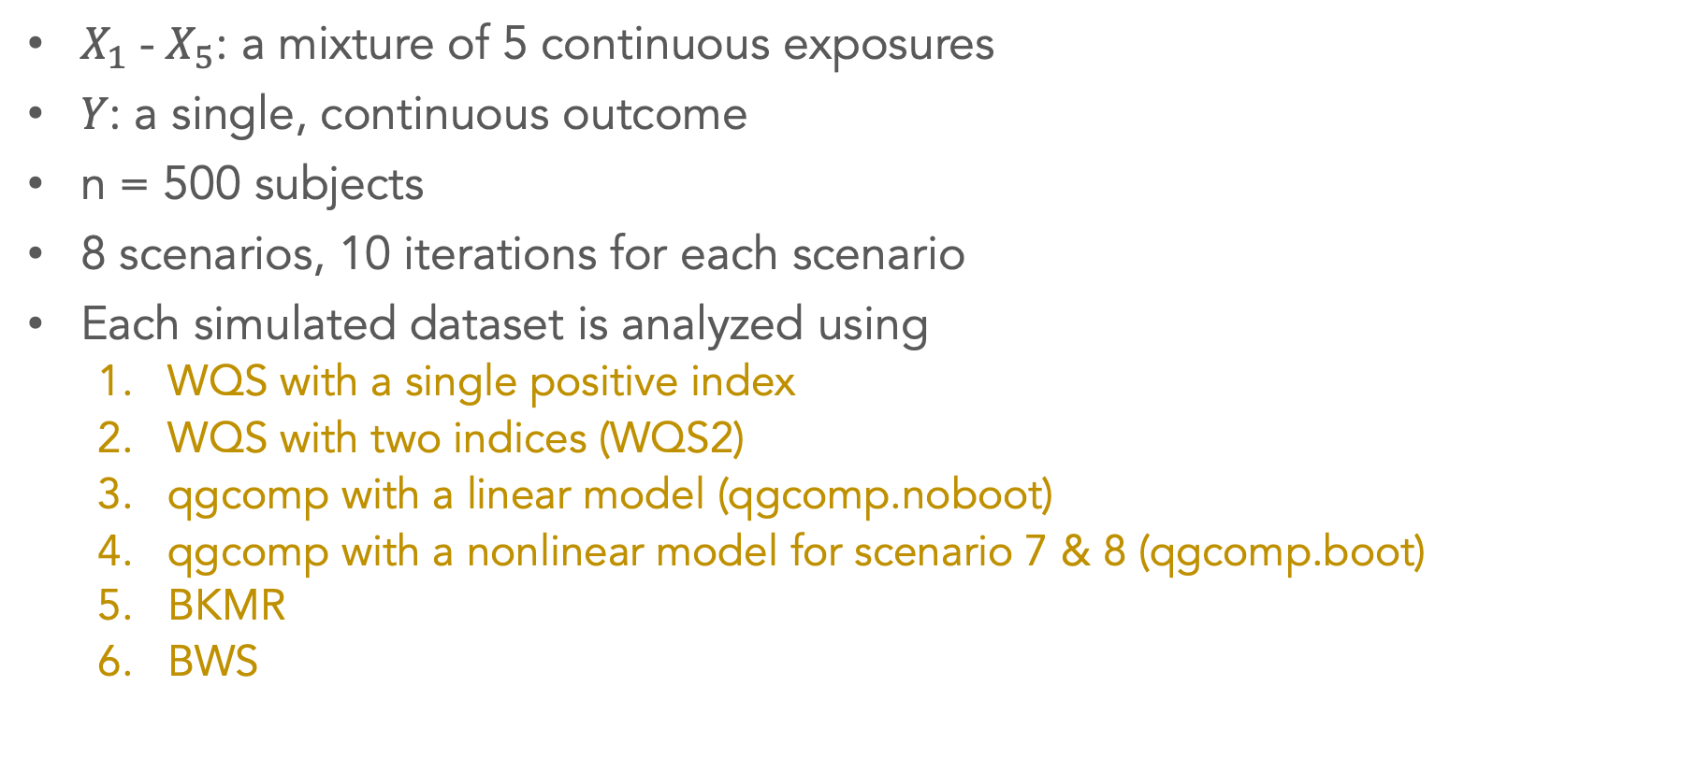
Simulation design
$X_{1}$ - $X_{5}$: a mixture of 5 continuous exposures
𝑌: a single, continuous outcome
n = 500 subjects
8 scenarios, 10 iterations for each scenario
Each simulated dataset is analyzed using
WQS with a single positive index
WQS with two indices (WQS2)
qgcomp with a linear model (qgcomp.noboot)
qgcomp with a nonlinear model for scenario 7 & 8 (qgcomp.boot)
BKMR
BWS
Notes:
Will increase the number of iterations to 100

Slide 6
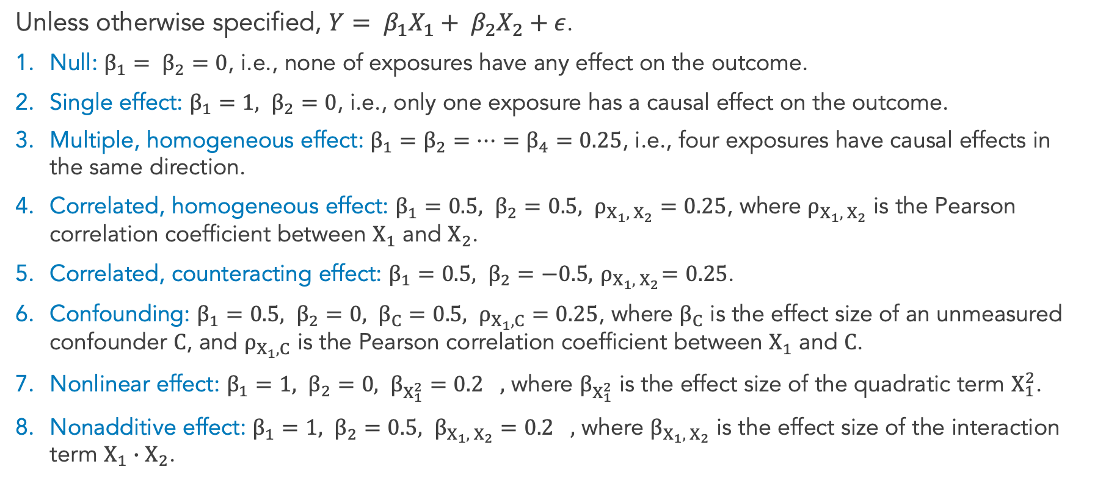
Simulation scenarios
Unless otherwise specified, $Y= β_{1}X_{1}+ β_{2}X_{2}+ε$.
Null: $β_{1}= β_{2}=0$, i.e., none of exposures have any effect on the outcome.
Single effect: $β_{1}=1, β_{2}=0$, i.e., only one exposure has a causal effect on the outcome.
Multiple, homogeneous effect: $β_{1}=β_{2}=⋯=β_{4}=0.25$, i.e., four exposures have causal effects in the same direction.
Correlated, homogeneous effect: $β_{1}=0.5, β_{2}=0.5, ρ_{X_{1}, { X}_{2}}=0.25$, where $ρ_{X_{1}, { X}_{2}}$ is the Pearson correlation coefficient between $X_{1}$ and $X_{2}$.
Correlated, counteracting effect: $β_{1}=0.5, β_{2}=−0.5, { ρ}_{X_{1}, { X}_{2}}=0.25$.
Confounding: $β_{1}=0.5, β_{2}=0, {β_{C}=0.5, ρ}_{X_{1}, C}=0.25$, where $β_{C}$ is the effect size of an unmeasured confounder $C$, and $ρ_{X_{1}, C}$ is the Pearson correlation coefficient between $X_{1}$ and $C$.
Nonlinear effect: $β_{1}=1, β_{2}=0, {β_{X_{1}^{2}}=0.2}_{},$ where $β_{X_{1}^{2}}$ is the effect size of the quadratic term $X_{1}^{2}$.
Nonadditive effect: $β_{1}=1, β_{2}=0.5, {β_{X_{1}, { X}_{2}}=0.2}_{},$ where $β_{X_{1}, { X}_{2}}$ is the effect size of the interaction term $X_{1}∙X_{2}$.

Slide 7
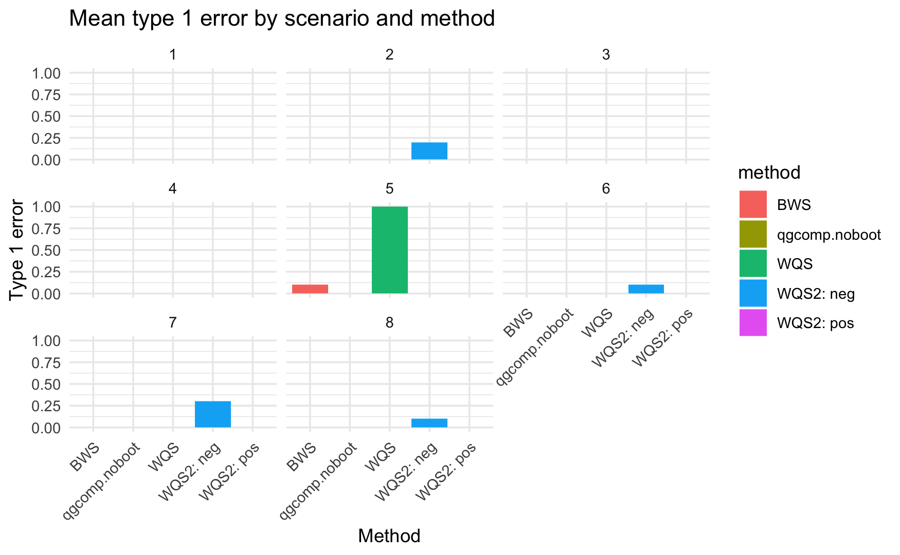
Mean type 1 error across 10 iterations
Type 1 error is calculated when the true joint effect is null
Scenario 1
Scenario 5 (except WQS2)
WQS2 in the negative direction (except scenario 5)
Null hypothesis test is valid when no exposure has an effect (scenario 1)
WQS falsely identifies a joint effect when two exposures have counteracting effects (scenario 5)
WQS2 produces high type 1 error when the true joint effect is nonlinear (scenario 7)

Slide 8
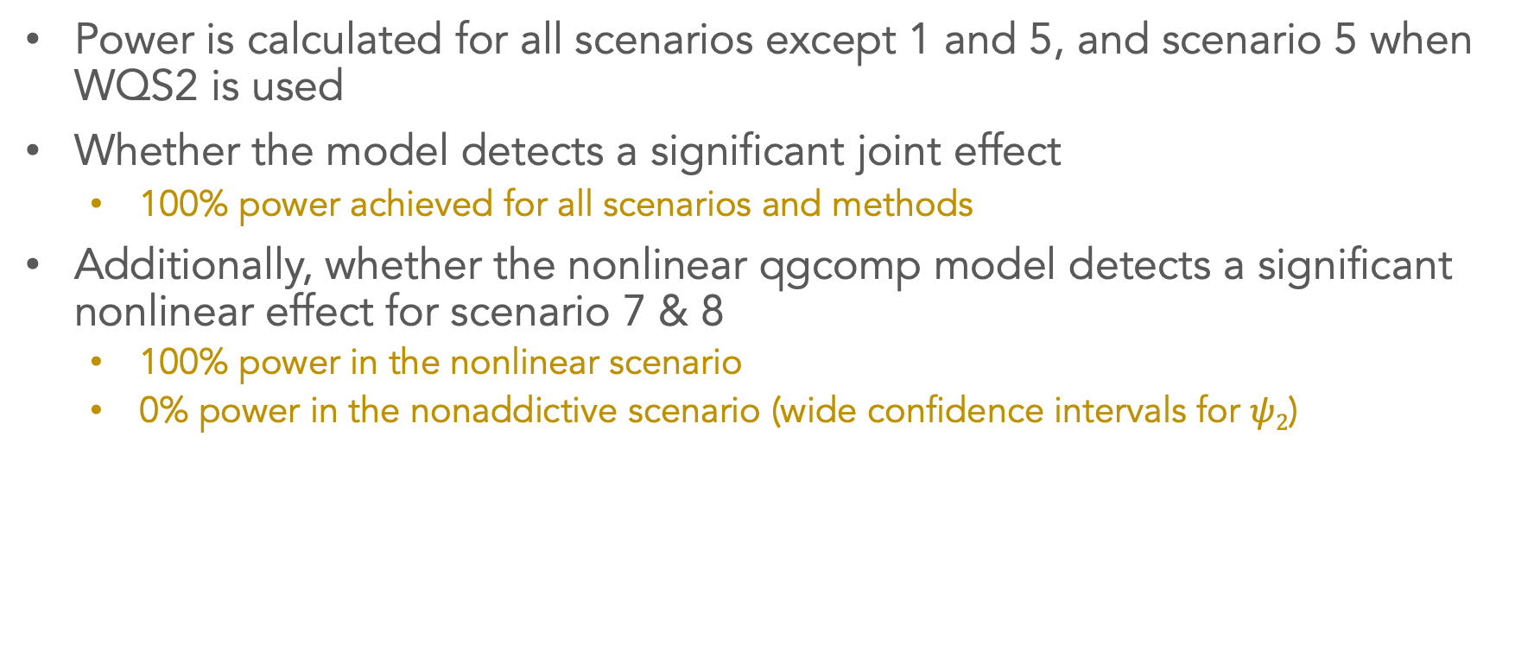
Mean power across 10 iterations
Power is calculated for all scenarios except 1 and 5, and scenario 5 when WQS2 is used
Whether the model detects a significant joint effect
100% power achieved for all scenarios and methods
Additionally, whether the nonlinear qgcomp model detects a significant nonlinear effect for scenario 7 & 8
100% power in the nonlinear scenario
0% power in the nonaddictive scenario (wide confidence intervals for $ψ2$)

Slide 9
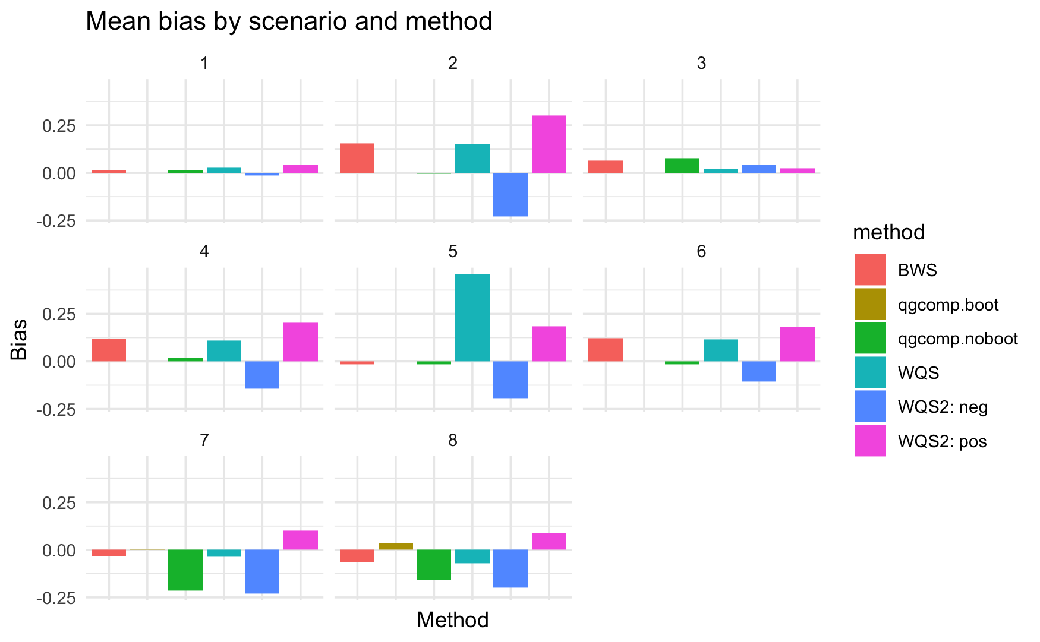
Mean bias of estimated joint effect
The true joint effect is calculated as the expected increase in Y when X₁-X₅ increase by 1 simultaneously
Linear qgcomp model is most robust to unmeasured confounding (scenario 6)
BWS and WQS are more robust to non-linearity and non-additivity when directional homogeneity holds (scenario 7 & 8)
Notes:
qgcomp.boot (nonlinear model) is only applied in scenario 7 & 8

Slide 10
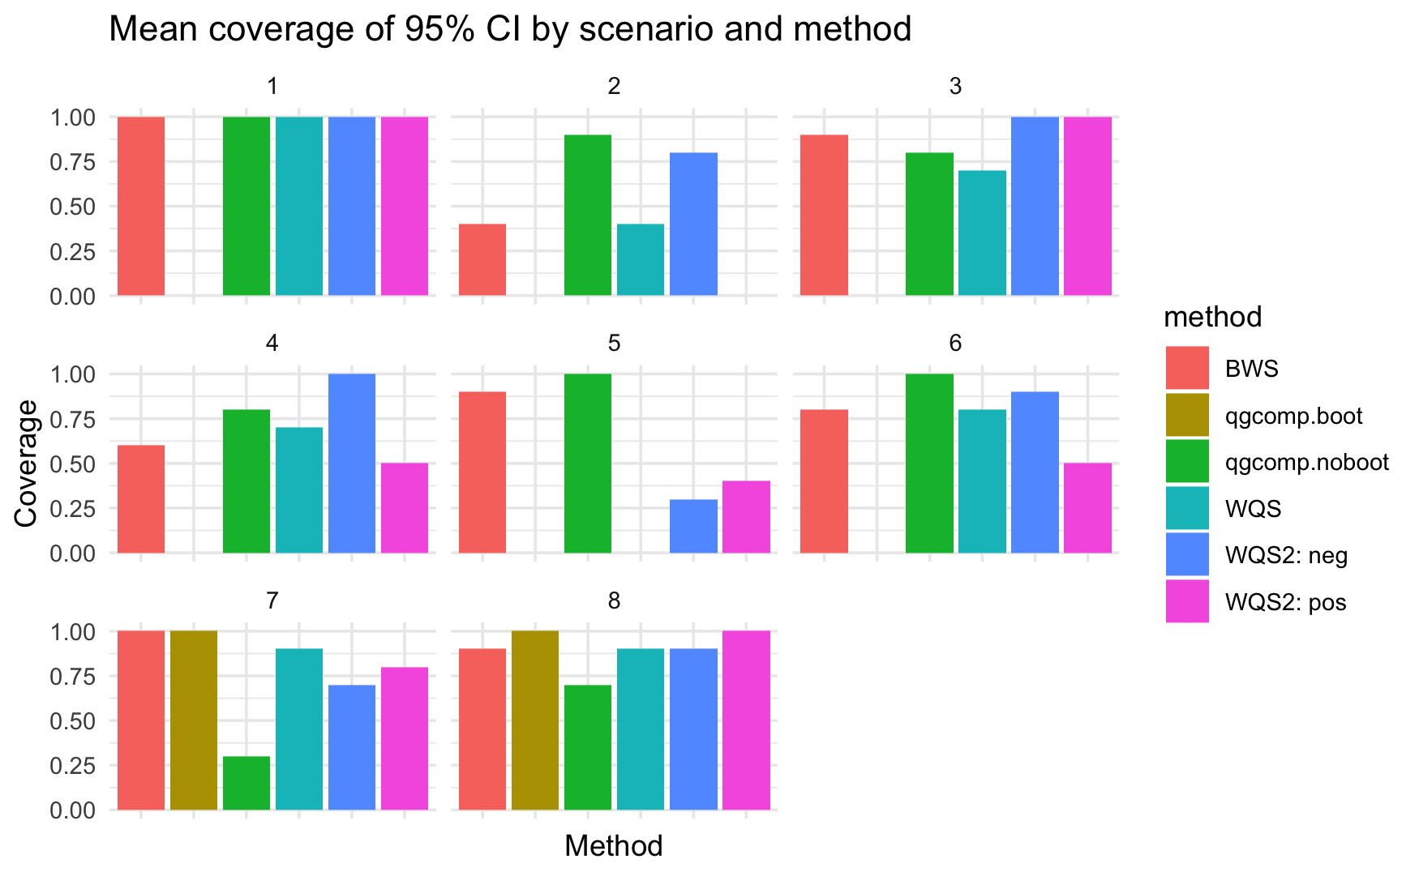
Mean coverage of 95% CI of estimated joint effect
Coverage of BWS, WQS, and WQS2 are poor in the single effect scenario (2)
Coverage of WQS2 in both directions are poor when there are counteracting effects (scenario 5)
BWS and qgcomp.boor perform well in non-linear and non-addicive scenarios
Notes:
BWS

Slide 11
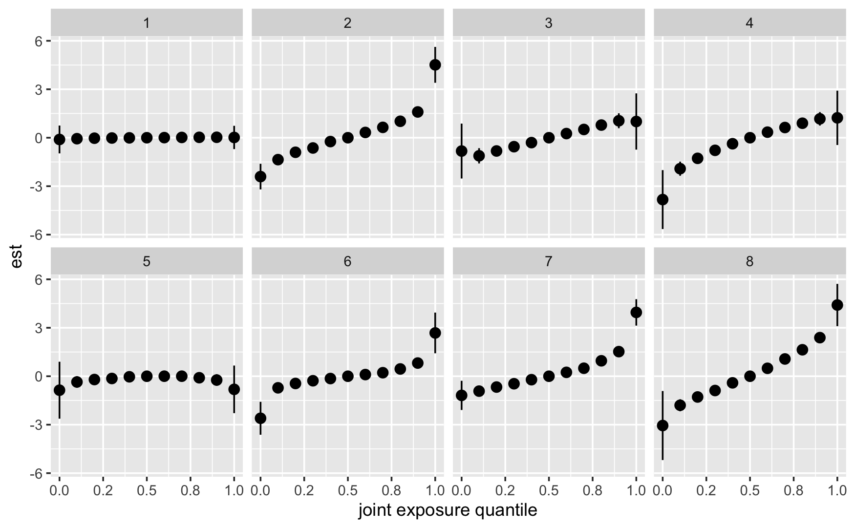
Estimated joint effect by BKMR
Point estimates show the difference in the value of h when all exposures are at a specified percentile (from 0th to 100th percentile) as compared to when all of them are at their 50th percentile.
Calculate mean integrated squared error (MISE)?

Slide 12
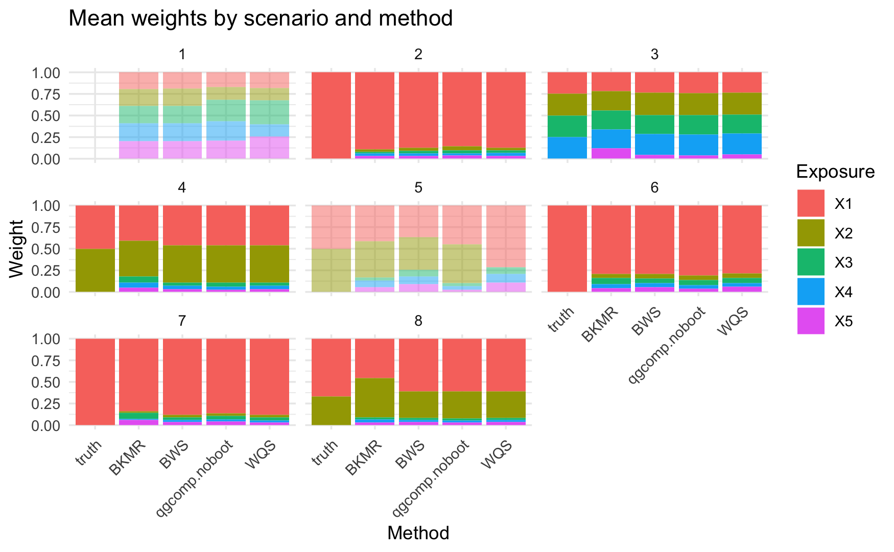
Mean weights for individual exposures
In scenario 1 and 5, the true joint effect is null
qgcomp weights are scaled by their positive or negative effect size
BKMR ‘weights’ are the scaled PIP values (sum to 1)
WQS, qgcomp, and BWS produce similar weight estimates when a significant joint effect is detected

Slide 13
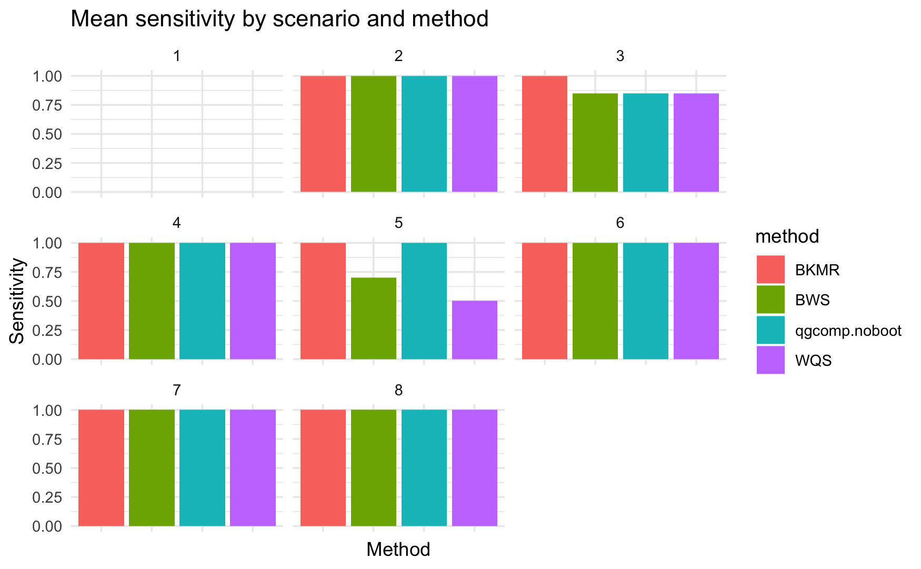
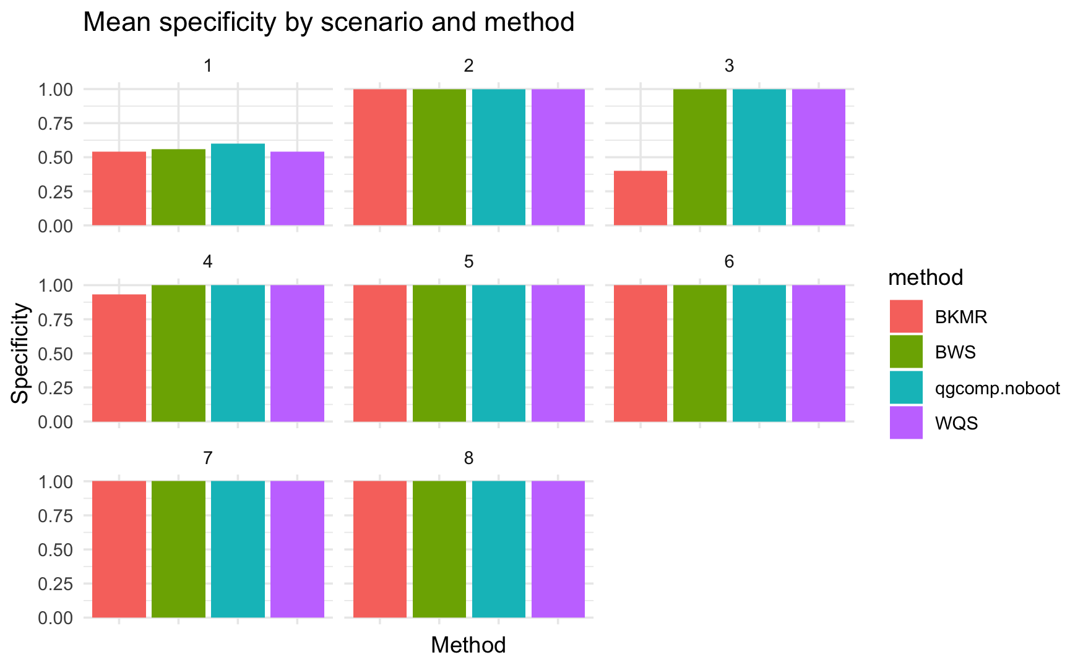
Mean sensitivity and specificity of weights
An individual exposure is considered “important” if its estimated weight > 0.2 or its estimated PIP > 0.5 from BKMR
Notes:
Sensitivity: BKMR performs the best when there are multiple, homogeneous predictors (scenario 3).
Qgcomp (linear) and WQS perform worse than BKMR and BWS in identifying true predictors in the counteracting scenario (5)
In other scenarios, all four methods achieve near-perfect sensitivity.
Specificity: BKMR has the lowest specificity when there are multiple, homogeneous predictors (scenario 3).

Slide 14
Discussion on simulation study
WQS with a single index performs poorly when directional homogeneity is violated.
Compared to WQS with a single index, WQS with two indices improves coverage in some scenarios, but also increases bias, especially when the true individual effects are homogeneous.
The linear qgcomp model runs the fastest and performs well in most scenarios when the true joint effect is linear. In non-linearity and non-additivity scenarios, it is outperformed by the nonlinear qgcomp model, BWS, and WQS.
BKMR provides comprehensive results and performs the best in identifying the true predictors. Hard to compare to other methods.

Slide 15
Discussion on simulation study
BWS perform well in most scenarios. It shows robustness to non-linearity and non-additivity in terms of low bias, high coverage of the joint effect and high sensitivity and specificity of weights.
BWS provides the easiest interpretation, while qgcomp (weights in two directions) and BKMR results are more difficult to interpret.
Recommended approach:
Use BWS for weight estimation
When applying qgcomp, assess the linearity of individual exposures first. If individual effects are linear, use the linear qgcomp model; otherwise, apply the qgcomp model with specified nonlinear terms.

Slide 16

Real data application
Childhood externalizing behaviors are characterized by acting out behavior difficulties with the environment
Prenatal indoor air pollution have been associated with childhood psychopathology
Occurs as a mixture of correlated pollutants
Questions:
1. Which indoor air pollutants are most harmful in relation to childhood externalizing behaviors?
2. What is the joint effect of prenatal indoor air pollution on childhood externalizing behaviors?

Slide 17

Drakenstein Child Health Study (DCHS)
A multi-year birth cohort study following mother-child pairs in South Africa (N = 599)
Indoor air pollution measurements were taken during 2nd trimester of pregnancy
Pollutants measured include particulate matter (PM10), carbon monoxide (CO), nitrogen dioxide (NO2), sulfur dioxide (SO2), benzene, and toluene
Childhood psychopathology was assessed using the Child Behavior Checklist (CBCL) at 6.5 years of age
113 questions, divided into internalizing and externalizing sub-scales
Covariates: maternal HIV status, maternal age, ethnicity (Black African versus mixed ancestry), and socioeconomic status

Slide 18
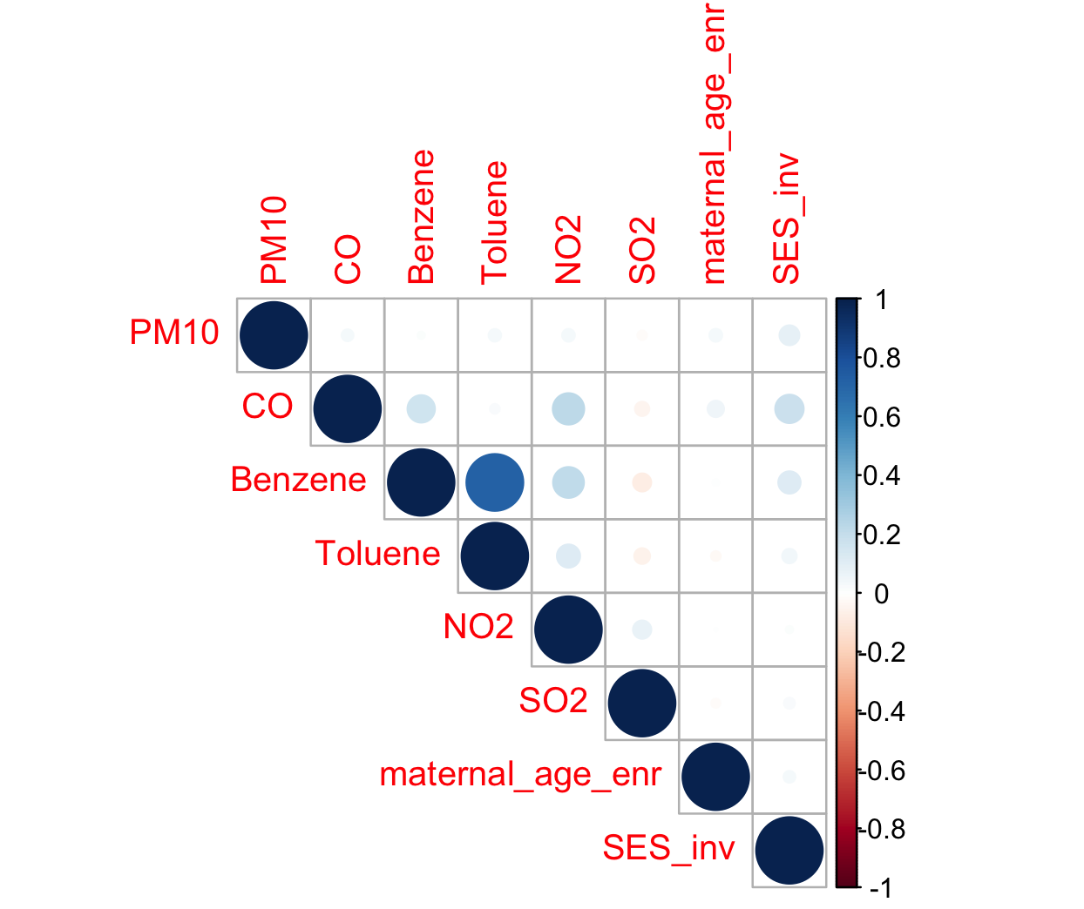
Pearson correlation between exposures and covariates
Data preprocessing:
Log-transformation on CBCL externalizing scores and exposures
Exposures are further centered and scaled for mixture models
High correlation between log-transformed benzene and toluene

Slide 19
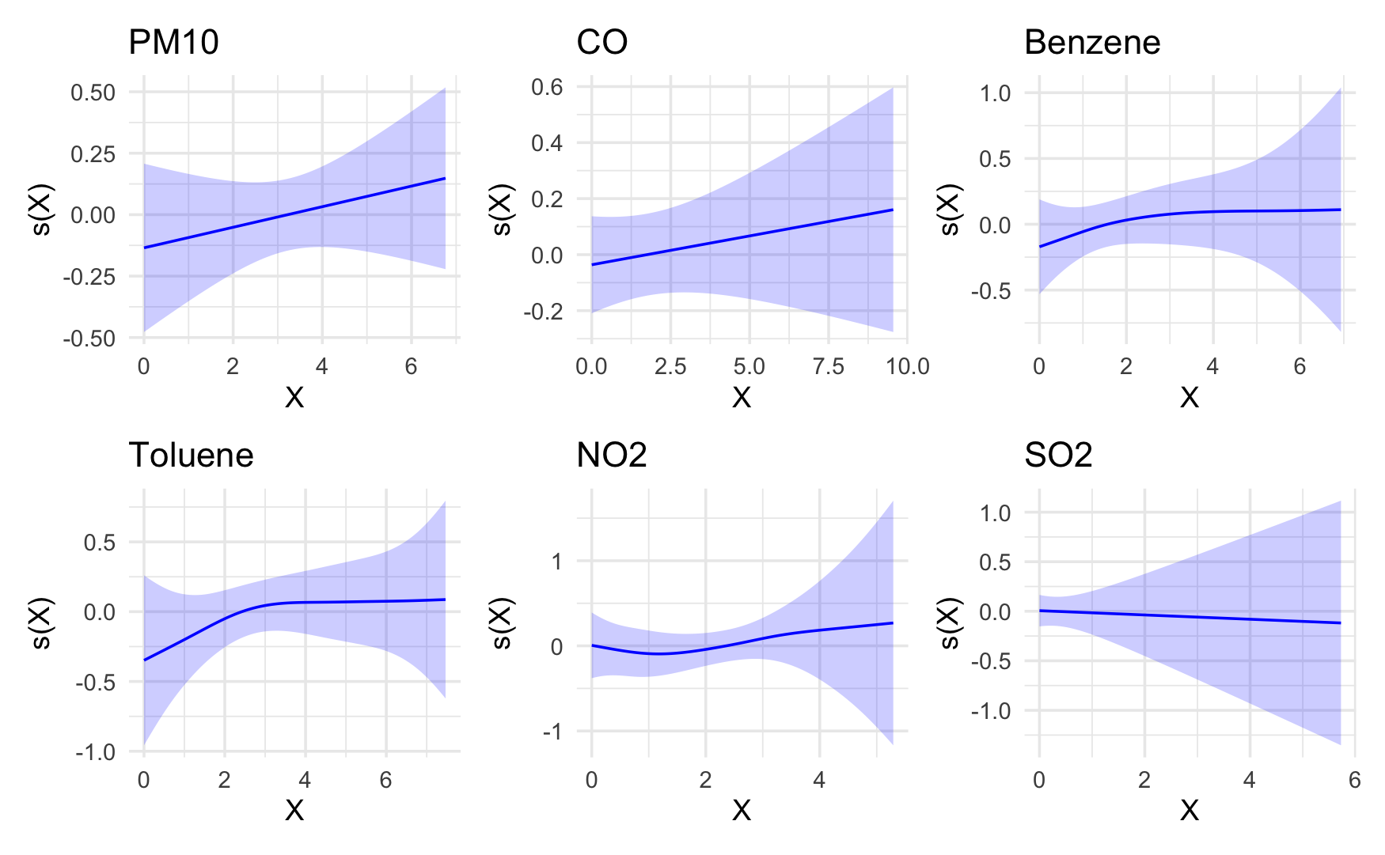
Individual effect: generalized addictive model (GAM)
None of the individual exposure-response relationship is significant
Toluene has a marginal p-value of 0.054
Nonlinear effects of benzene, toluene, and NO₂

Slide 20
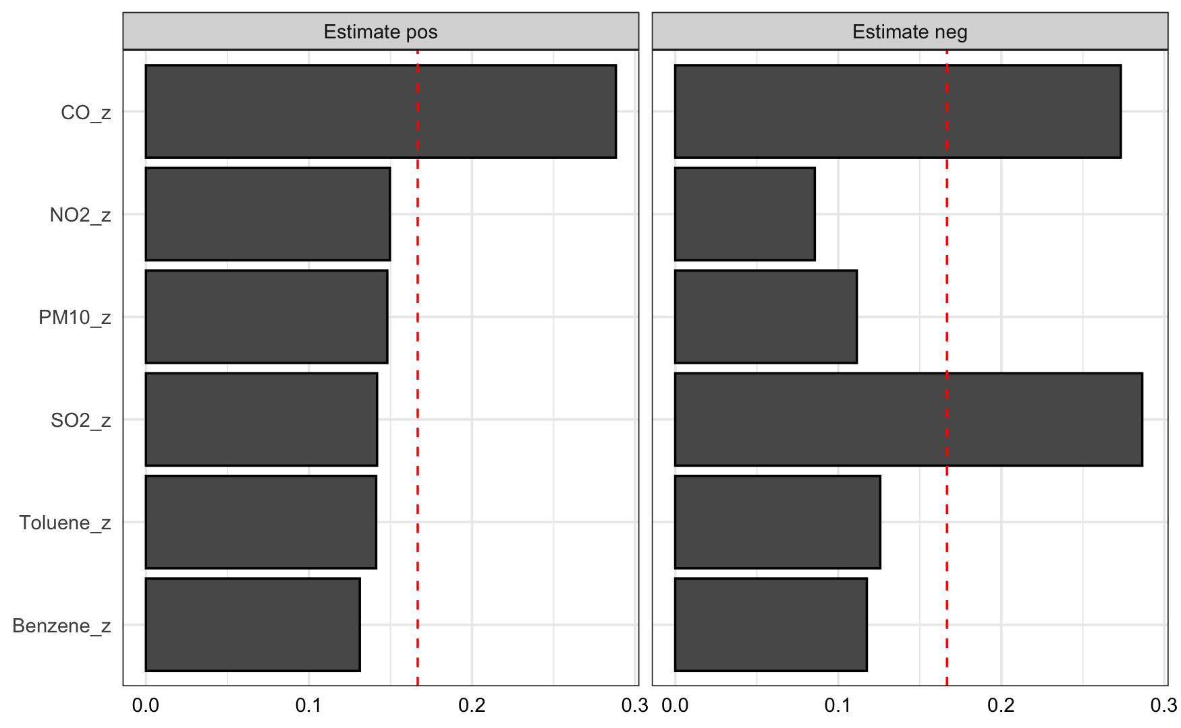
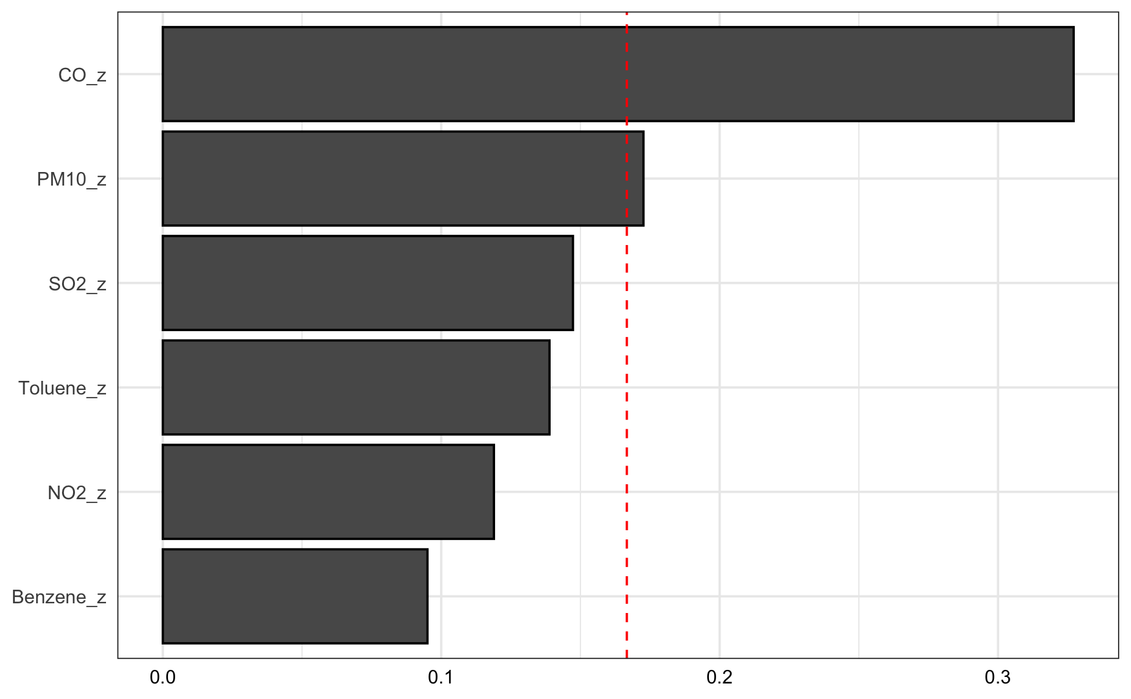
Joint effect: WQS and WQS2
WQS:
Significant positive joint effect (beta: 0.087; 95% CI: 0.005, 0.168)
CO is the largest contributor
WQS2:
Significant negative (beta: 0.122; 95% CI: 0.031, 0.213) and non-significant positive joint effect (beta: 0.003; 95% CI: -0.102, 0.108)

Slide 21
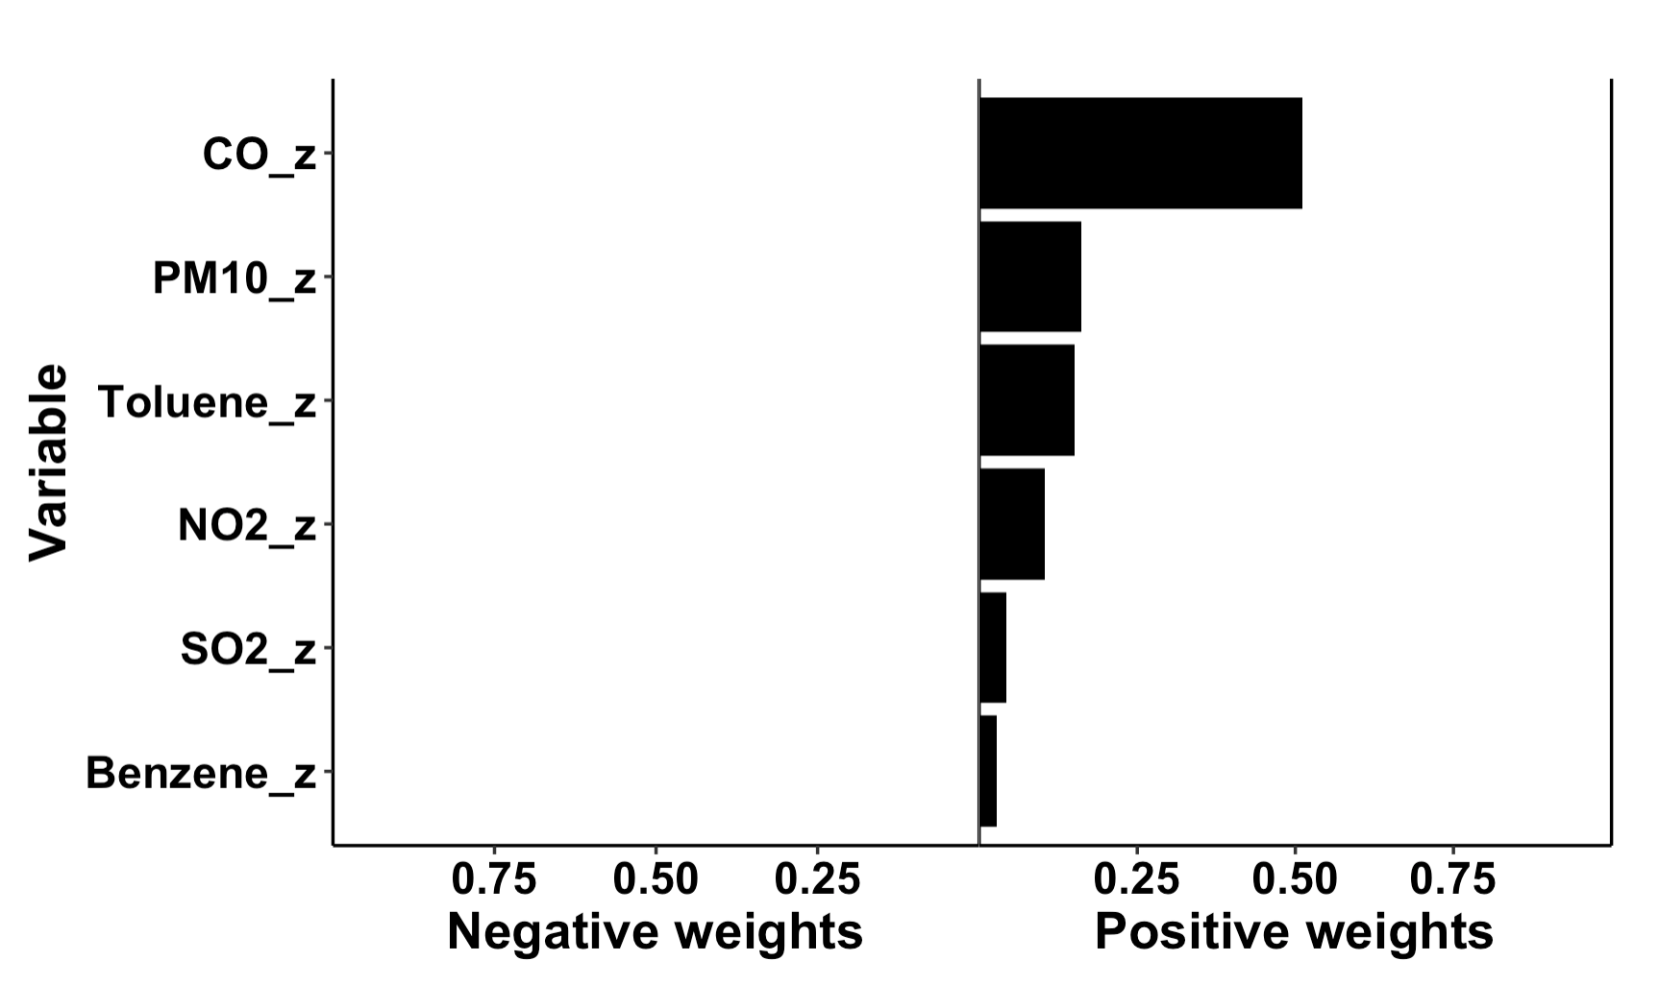
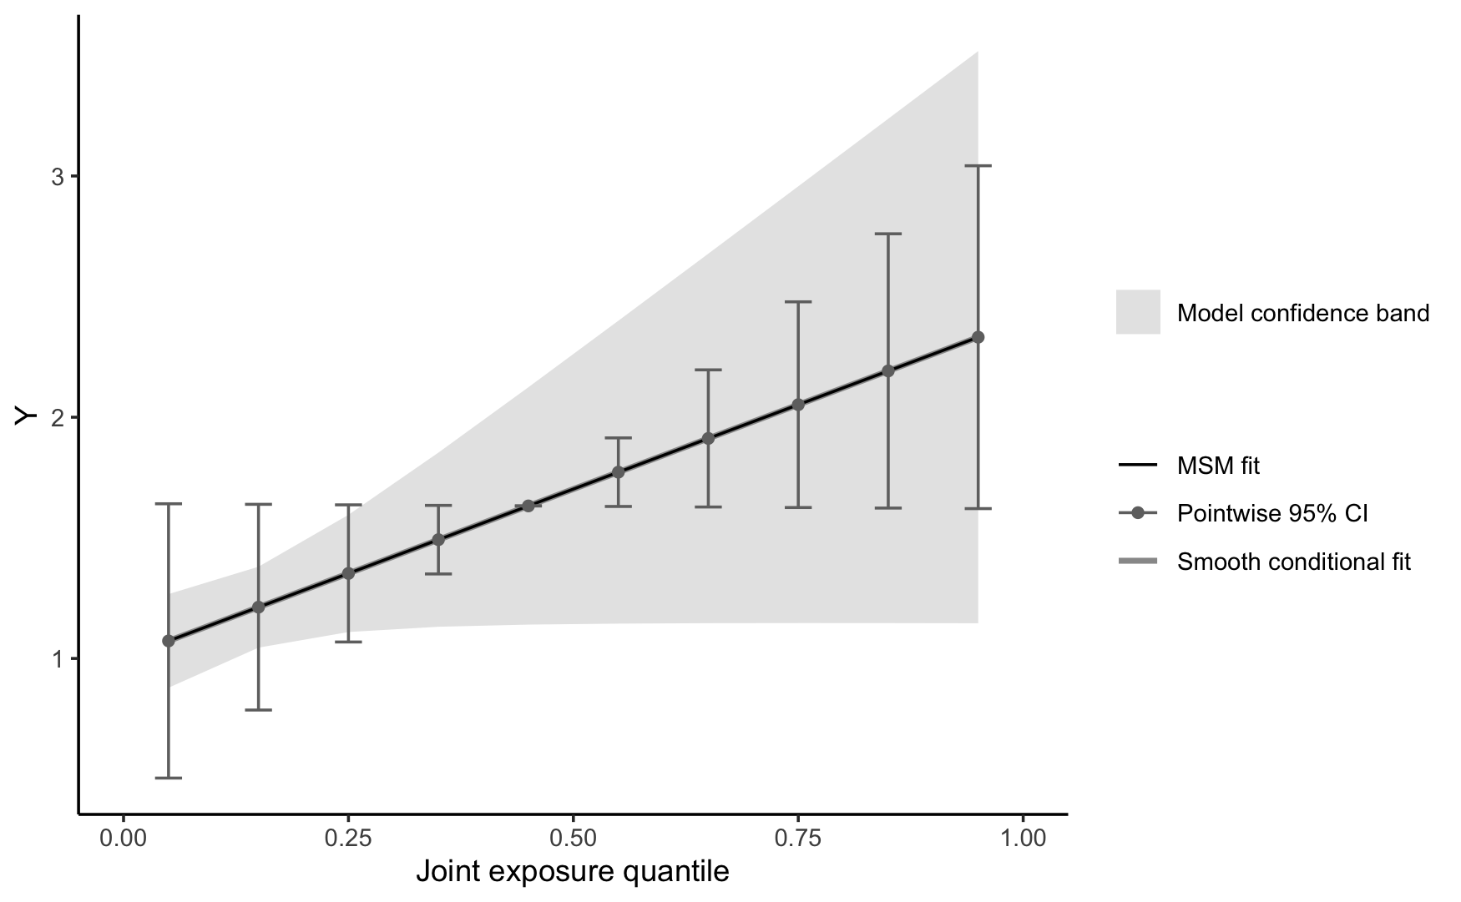
Joint effect: qgcomp
Linear qgcomp model:
Significant joint effect (psi: 0.140; 95% CI: 0.001, 0.279) in the positive direction
CO is the largest contributor
Nonlinear qgcomp model:
Uses splines to capture the nonlinear individual effects of benzene, toluene, and NO₂ and allows the joint effect to take a cubic form
AIC and BIC suggest that linear model is better

Slide 22
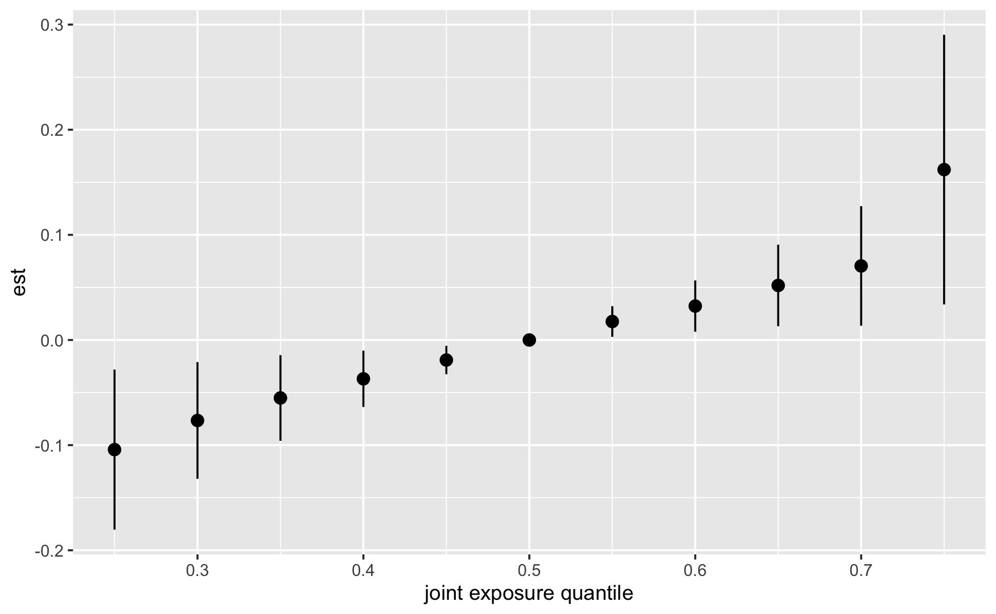
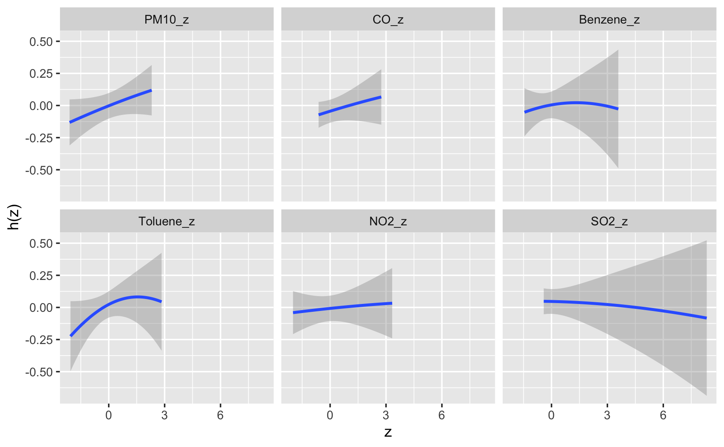
Joint effect: BKMR
Approximately linear joint effect in the positive direction
Toluene, CO and PM10 contribute the most
Suggests nonlinear effects for benzene, toluene, and NO₂
Notes:
Figure 1: difference in the value of h when all exposures are at a specified percentile (from 25th to 75th percentile) as compared to when all of them are at their 50th percentile.
Figure 2: univariate relationship between each exposure and the outcome, where all of the other exposures are fixed to the 50th percentile

Slide 23
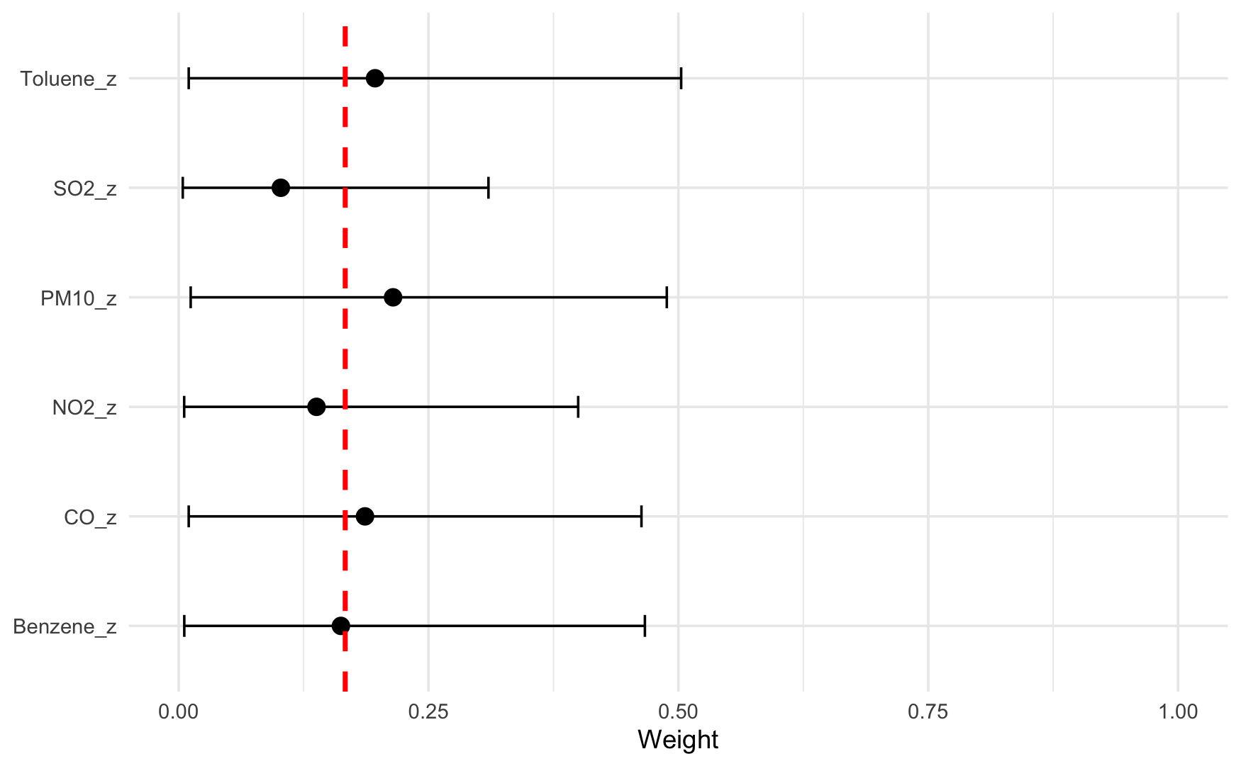
Joint effect: BWS
Significant joint effect (theta: 0.17; 95% CI: 0.04, 0.31) in the positive direction
PM10 is the largest contributor, followed by toluene and CO

Slide 24
Discussion on real data application
All mixture methods (except WQS) identify a positive joint effect of prenatal indoor air pollution on childhood externalizing behaviors
Toluene, CO, and PM10 emerge as the most harmful pollutants, though their rankings vary across different mixture methods
For WQS, fitting with positive and negative indices may introduce bias in results

Slide 25
Questions for the group
Any suggestions on the simulation design and performance metrics?
How to make comparison between BKMR and the other methods?
Targeted journal?

Slide 26
Thank You!

